Slide 1
Supply Chain Strategies: North America in a Chaotic World
This presentation is intended for the general information of individuals and organizations on matters of current interest. It is not legal advice. Participants should not act on the information in this presentation without professional counsel. Participating in or viewing this presentation is not intended to establish and does not establish an attorney/client relationship with Thompson Hine LLP.
St. Patrick’s Day 2022

Slide 2
HOW’D WE GET HERE
2

Slide 3
The Long Thaw . . . 1990s-2010s
SECURITY:
Issues with the Former USSR, Nuclear Non-Proliferation, old fights from WWI and WWII
TECHNOLOGY:
Internet, E-Commerce, Analytics
TRADE:
CUSFTA, NAFTA, DR-CAFTA, WTO
3

Slide 4
The Long Thaw (cont.)
September 11, 2001 and Global War on Terror
Great Recession
Fukushima
Recovery
Rising Political Change / Populism
4

Slide 5
Meanwhile . . .
Interconnected Global Trade Networks
Rise of China Post-Recession
Collapse of WTO Doha Round
Plurilateral/Regional Agreements/Bilats
All leading to TPP (now CPTPP) and TTIP for US
5

Slide 6
“Rebalance” (2016-2020)
Safeguards (201)
Steel and Aluminum (232)
China (301) + AD/CVD
NAFTA to USMCA
Korea / Japan / Africa
6

Slide 7
CUSMA/ACEUM USMCA/TMEC
7

Slide 8
The Road to the New NAFTA …
At least 20 yrs. of negative views toward NAFTA in U.S. in industrial Midwest (auto), Carolinas (textiles, furniture), Northeast (apparel), Florida (tomato wars), etc.
“Standby” mode during post-9/11, Great Recession, Recovery
No will in Security Prosperity Partnership (SPP), Beyond the Border (BtB), Regulatory Cooperation Council, Bilats
Trade & Undocumented Migration Issues Come Together
The end of the “North American Platform”
All leading to a volatile situation with Democrats and Republicans
8

Slide 9
New NAFTA: The Three U.S. Objectives
China, China, China
Labor Issues in Mexico
Michael Corleone Strategy
Dairy, NFL, De Minimis/LVS, Mexican Trucking, etc.
But . . .Softwood and Tomatoes “Ring-fenced”
*Market Access Not a Key Negotiating Topic for U.S.*
9

Slide 10
New NAFTA or The “Renovation” of NAFTA?
Fresh Coat of Paint: Real competitiveness on areas such as polymers, chemicals, coatings, importing raw materials to process, sectoral annexes.
New Fixtures and Appliances: Digital, Customs and Trade Facilitation (Border), Competitiveness, Regulatory Cooperation, Sunset/Refresh.
Tear Down Walls/New Structures: Auto Rules of Origin, Rapid Response Labor Enforcement Mechanism, Environment, Dispute Resolution Mechanisms.
10

Slide 11
Here We Go Again…
Dispute Centric: RRLEF(Labor), Dairy, Auto ROO, GMO/Ag/Biotech in Mexico (resolved?), Energy, Vaquita Porpoise, Solar and now EV in U.S.
No from POTUS, PM, AMLO but . . .USTR, Congress, Labor are supporters.
No Private Sector: No discussion/champions in private sector re: the “wins” for North America/Canada-U.S.
11

Slide 12
COVID-19, Congestion, Circular
Promote complete 24/7 operations within all US Ports (US is a global exception without this now & viewed as the global bottleneck)
Increase the trust and cooperation of US and China trade relationship to reduce possibilities of taking the ‘container’ as political hostage
Increase driver hours of service rules flexibility
Add financial support for logistics Industry to achieve the points above
Restrict ocean carriers’ ability to take empty containers back to Asia
Invest in automation at ports
Invest in chassis production and rail infrastructure
12

Slide 13
Costs / Cyclical
This is not transitory.
Mid-long range concerns re: costs being “locked-in” now for 3-5 years. Carriers/Service Providers have maximum leverage and are requiring contracts with longer term provisions.
Bidding cycles were delayed in 2020; “mad scramble” for shippers to get as many providers under contracts as possible. Entirely a “Just In Case” environment with increasing costs.
Clients report a 50% increase in air cargo utilization with increased costs and accompanying GHG emissions.
Warehousing shortage and need to “lock-in” and have redundancy.
The company-level, micro decisions will have the macro effect of the mid-long range inflationary environment on just transportation costs alone.
13

Slide 14
China
Long-Term Lifting of Section 301 tariffs on COVID-19 related imports (per section on COVID).
Long-term extension of all existing Section 301 tariff exclusions.
Review Section 301 Lists III and IV and align with supply chain priorities developed by both countries (Legal Action Pending).
North American/Global Coordination of AD/CVD at least shared monitoring systems of products such as steel, aluminum, and other areas of priority.
Clarity and Coordination regarding forced labor enforcement and outreach to respective business communities particularly SMEs.
14

Slide 15
Competitiveness / “Rebuild”
Continental competitiveness is the relentless positive action to complement the enforcement side of the China issue.
All Supply Chain strategies issued by the respective governments should call to mind continental competitiveness (e.g., “ally-shoring”, hybrid industrial policy, Canada’s Strategic Innovation Fund, U.S. Mexico-Foundation Reports).
Critical Minerals.
Shared Regulatory Cooperation during development on issues such as AI, autonomous vehicles, advanced air mobility, agriculture including organics, cyber and ICT.
Renewed focus on regulatory cooperation in pharma and digital services taxes.
Talent Mobility/Business Immigration/Trilateral Skills Certification for Trades.
15

Slide 16
What’s Next
Russia-Ukraine “Rethink” on “Rebuild”-Energy?
Does Inflation give the Space to rethink China Tariffs or to say let’s go all in on rebalance?
Watch Buy America(n), Build Back Better, Supply Chain reports issued in Feb. 2022.
16

Slide 17
Ft. Bend as the Heart of It All
Geographically positioned as a North American and Lat-Am hub but also a global gateway
Positioned for the future supply chains / integration
Talent

Slide 18
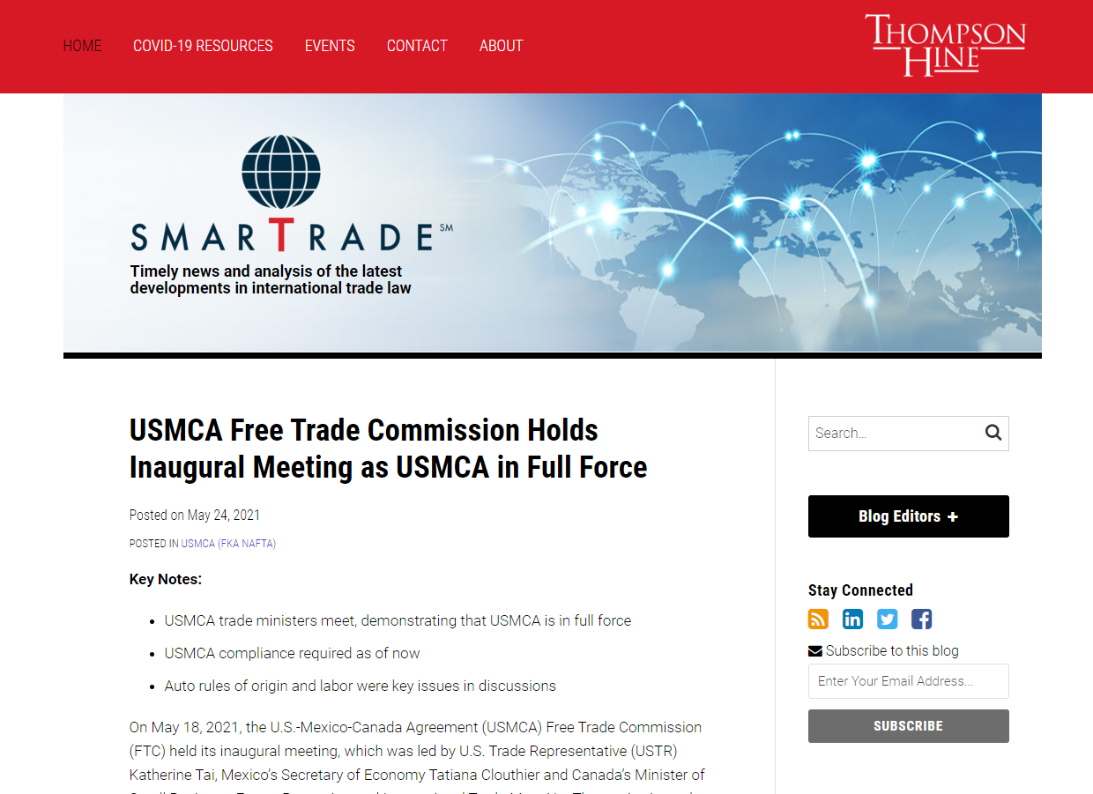
We invite you to stay abreast of continuing trade developments via our blog, ThompsonHineSmartTrade.com. To receive an email notification whenever a new post is published, please subscribe to the blog.

Slide 19
Questions?
Dan Ujczo dan.ujczo@thompsonhine.com
614-271-8355 (m)
614-469-3319 (o)

